Slide 1
GPU Graftals: Stylized Rendering of Fluffy Objects
Michael Lester

Slide 2
Background

Slide 3

Adapting 2D fur techniques to 3D
Easy to do in Film
Fixed viewpoint
Hard for interactive scenes
Dynamic viewpoint
How does fur react to changes in camera position?

Slide 4
Possibilities
Static Geometry
(Built into 3D model)
Potentially expensive
No easy fur animation
No Level of Detail
Not art-directable
No control over fur
Inflexible
Dynamic Geometry
(Generated at run-time)
Potentially expensive
Easy to animate
Level of Detail
Art-directable
Controllable (size, length, ...)
Flexible
Notes:
With Dynamic Geometry, we have complete control over every piece of fur

Slide 5
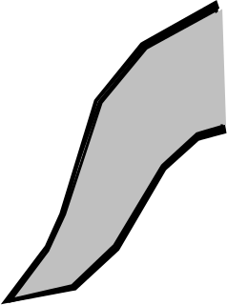
What's a GPU Graftal?
A Graftal is a small "fin" of geometry, many Graftals are used on an object to represent fur/complexity. (Introduced in Kowalski '99)
GPU refers to the fact that these graftals are rendered entirely on the graphics processing unit.
A Graftal has many components:
Position (on the object)
Orientation
Level-of-Detail
Geometry
Lines or "Strokes"
Animation state
Etc...
Notes:
A graftal is a single piece of “Dynamic Geometry”, and it represents a single tuft of fur
It’s constructed as a “fin”, or a 2D geometry that always faces the camera.
The “GPU” in “GPU Graftal” refers to the fact that graftals in this system, unlike the original introduced by Kowalski (way back in ‘99), are implemented entirely on the GPU
This results in orders-of-magnitude better performance, as we’ll see later
Each graftal has many properties that we can control, a few are listed below
All of these values are artist tunable, so we can generate many different styles
Very Flexible!

Slide 6
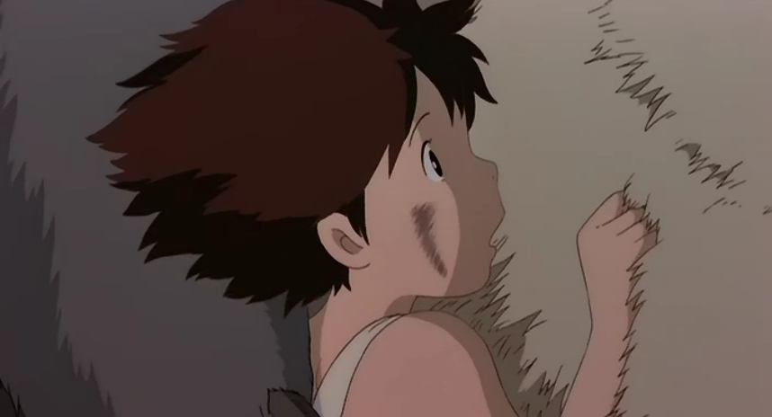
Graftal Example
Line + Geometric Graftals
Shadow Graftals
Proximity-Activated Graftals

Slide 7
Demo

Slide 8
GPU Graftals

Slide 9
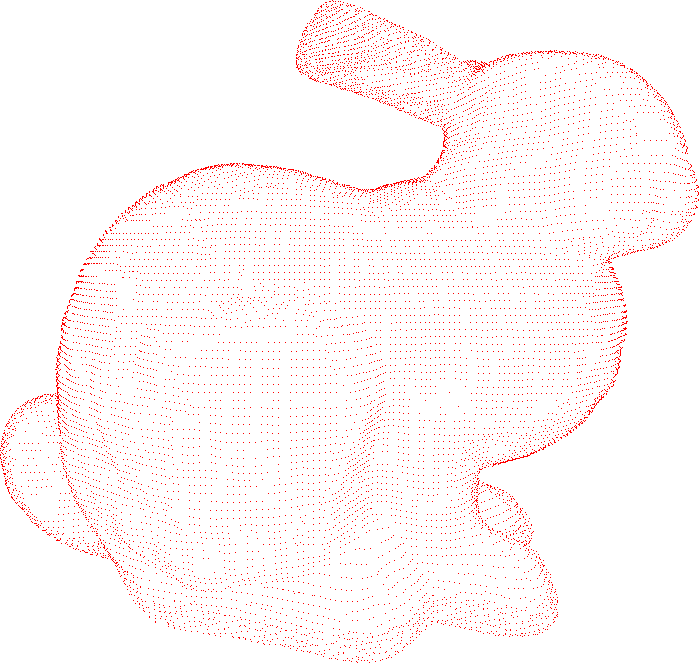
Initial Graftal Placement
Place a graftal at each vertex
Graftal density depends on mesh
Tons of room for improvement
Notes:
Works for this model, but the results won’t be as good for less detailed models.

Slide 10
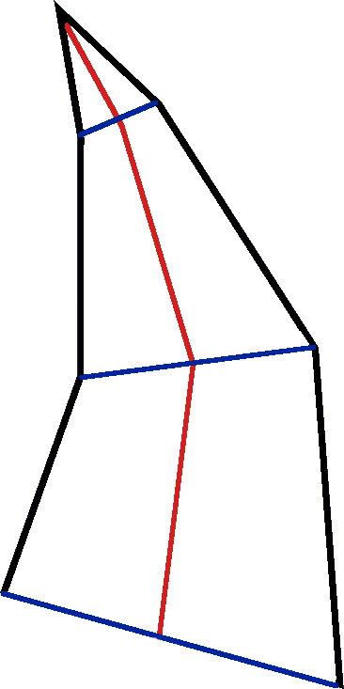
Graftal Expansion
Represented as a central “spine”
Blue points on the right
Expanded to a 3D “fin” in a geometry shader
Spinal representation allows for easy animation
More flexibility!
Notes:
Works for this model, but the results won’t be as good for less detailed models.

Slide 11
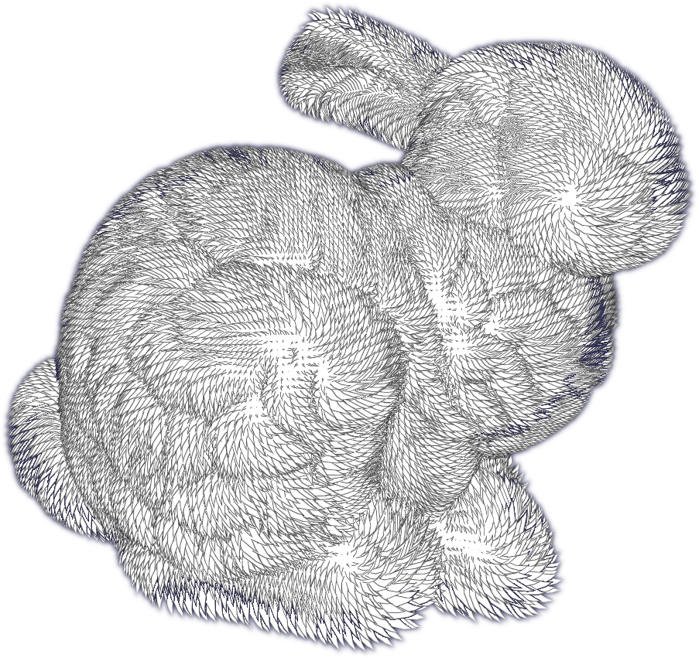
Uniform Graftals
Graftals placed at every vertex
Graftals have uniform properties
Size, length, normal
Looks interesting, but not artistic

Slide 12
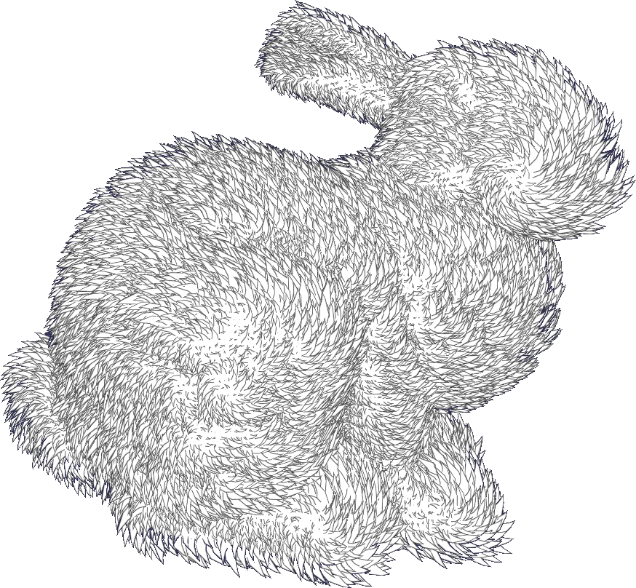
Perturbed Graftals
“Randomized” normals, sizes, lengths
Looks more natural
Not quite artistic
Too busy

Slide 13
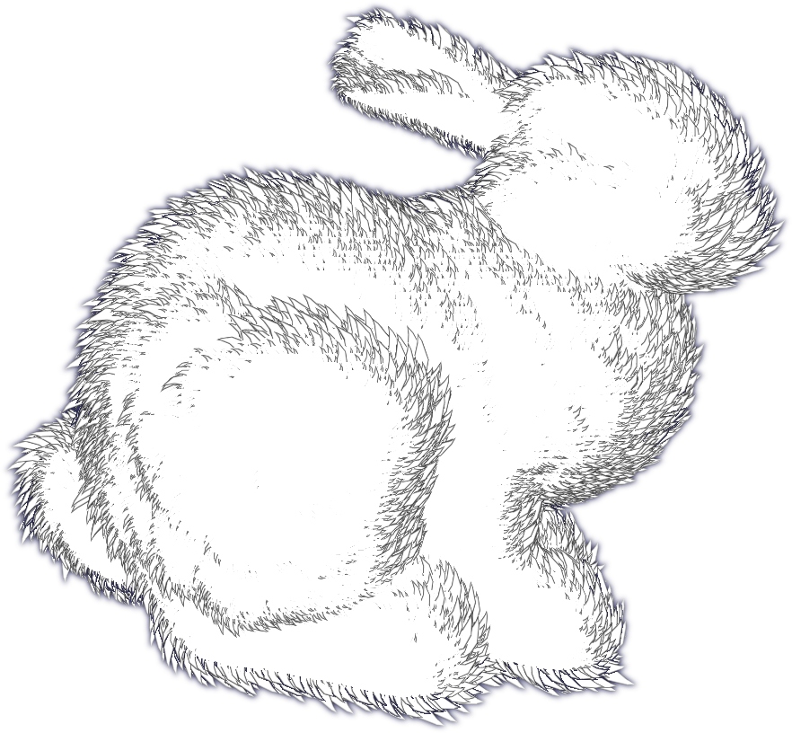
Silhouette Graftals
Scale graftals based on dot(Normal, View)
Emphasize graftals on object edges
Efficiently!
Notice the grid noise
Result of initial placement

Slide 14
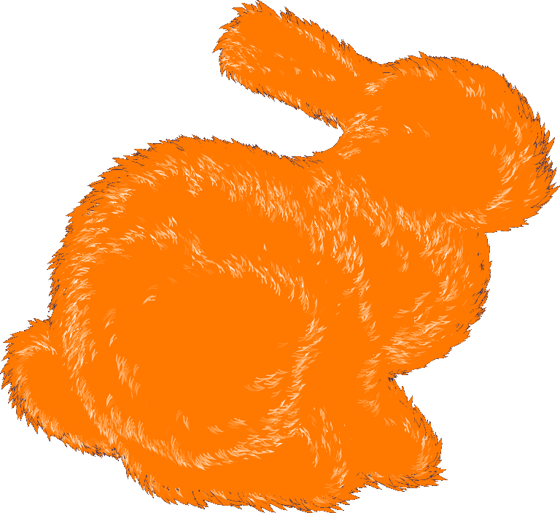
Multiple Levels of Detail
Graftals sorted into multiple Levels of Detail
Based on dot(N,V)
Rendered in different styles

Slide 15
Performance (the most important part)
GeForce 8800 GTS (low-end)
Frame Budget: 16ms for 60 fps
2ms is a great graftal budget
Stages | Time (ms) | # Graftals | Time/Graftal
Culling | 0.09 | 70,000 | ~
LOD Sort #1 | 0.05 | 35,000 | ~
LOD Sort #2 | 0.03 | 35,000 | ~
LOD Draw #1 | 1.2 | 7,000 | 170 ns
LOD Draw #2 | 0.3 | 2,700 | 110 ns
Total: | 1.67 ms | 70,000 | 23 ns

